Slide 1
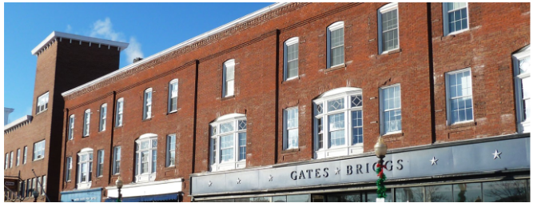
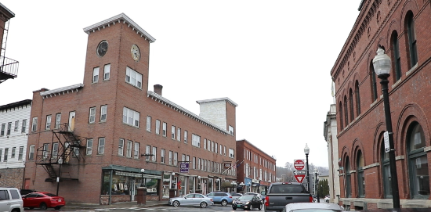
Town of Hartford Energy Commission
Key Points:
Process
  Governance
  Mandate / CAP
Collaboration
  Neighboring Towns
  University Orgs
  NGOs
Whats Next?

Slide 2
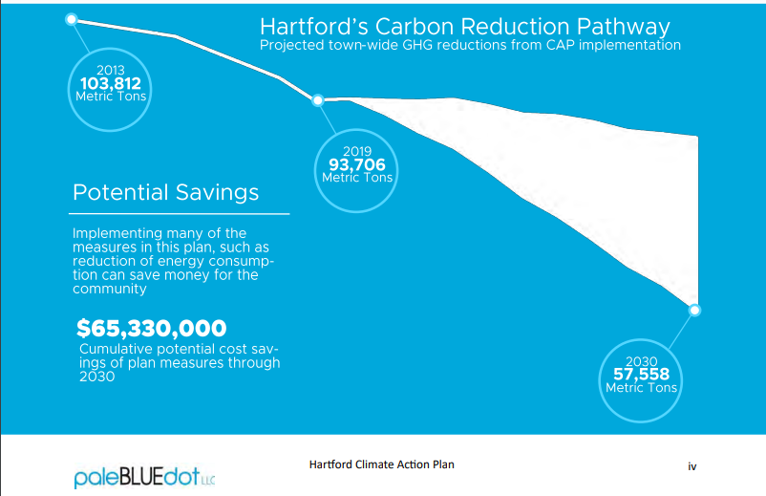
Town of Hartford Energy Commission
Governance
  Volunteer-run Energy Commission
    Climate Action Steering Committee
    Dedicated Climate Fund
    No grant writer…
  Reports to / Advises Selectboard
  Dedicated support from Town Staff
Mandate
  Resolution: “<The Town shall be> net zero by 2030…”
  Ballot Measure: “municipal… operations shall achieve carbon neutrality by 2027”
#1 Process:

Slide 3
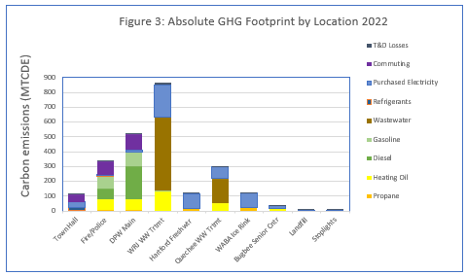

Town of Hartford Energy Commission
#1 Process:
Assumes ISO_NE grid blend rather than GMP resource mix
Includes carbon emissions related to wastewater treatment

Slide 4
Town of Hartford Energy Commission
#1 Process:
—----------------------------------
Transportation
—---------------------
Heating

Slide 5



Town of Hartford Energy Commission
Neighboring Towns!!!
  We all have lessons, wisdom and resources to share!!
NGOs / SMEs (to name a few….)
  UNH Carbon Clinic
  Dartmouth Energy Justice Clinic
  VLGS Energy Clinic
  Window Dressers
  Vermont Works for Women
  Vital Communities
  Vermont Community Geothermal Alliance
  Vermont Clean Cities Coalition
#2 Collaboration:

Slide 6

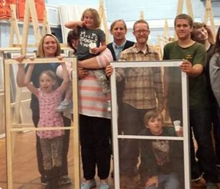

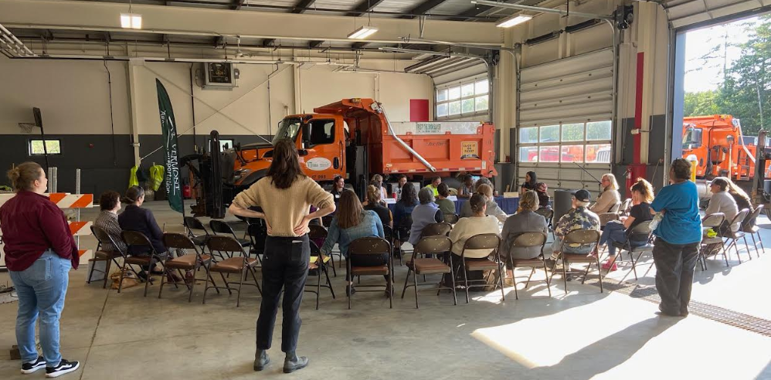
Town of Hartford Energy Commission
Neighboring Towns!!!
  We all have lessons, wisdom and resources to share!!
NGOs / SMEs (to name a few….)
  UNH Carbon Clinic
  Dartmouth Energy Justice Clinic
  VLGS Energy Clinic
  Window Dressers
  Vermont Works for Women
  Vital Communities
  Vermont Community Geothermal Alliance
  Vermont Clean Cities Coalition
#2 Collaboration:

Slide 7



Town of Hartford Energy Commission
Neighboring Towns!!!
  We all have lessons, wisdom and resources to share!!
NGOs / SMEs (to name a few….)
  UNH Carbon Clinic
  Dartmouth Energy Justice Clinic
  VLGS Energy Clinic
  Window Dressers
  Vermont Works for Women
  Vital Communities
  Vermont Community Geothermal Alliance
  Vermont Clean Cities Coalition
#2 Collaboration:

Slide 8
Town of Hartford Energy Commission
Municipal Operations (con’t…)
  Transportation
    Landscaping Equipment (Parks & Rec)
    Idle Mitigation (Ambulance, Police Cars)
  Heating
    Senior Living Center
      Insulation, Air Seal, Ventilation
      Heat Pump
    Heat Pump for WWTF
    DPW Boiler Replacement
Townwide / Community Projects
  Individual Contributions + Support (i.e. residential electrification, weatherization’ EVs)
  Community Thermal Energy Network / Utility
  Exploring additional solar BTM / NM Opportunities
#3 What’s Next?

